Slide 1
Human Foods Program

Slide 2
Toxicokinetic Chemical Simulator (ToCS): A Graphical User Interface for High-Throughput Chemical Analysis
Kristen Windoloski, Contractor Office of Scientific Coordination and Computational Sciences (OSCCS) Office of Laboratory Operations and Applied Science (OLOAS)

Slide 3
Session II: Concentration-Time Profile Module

Slide 4
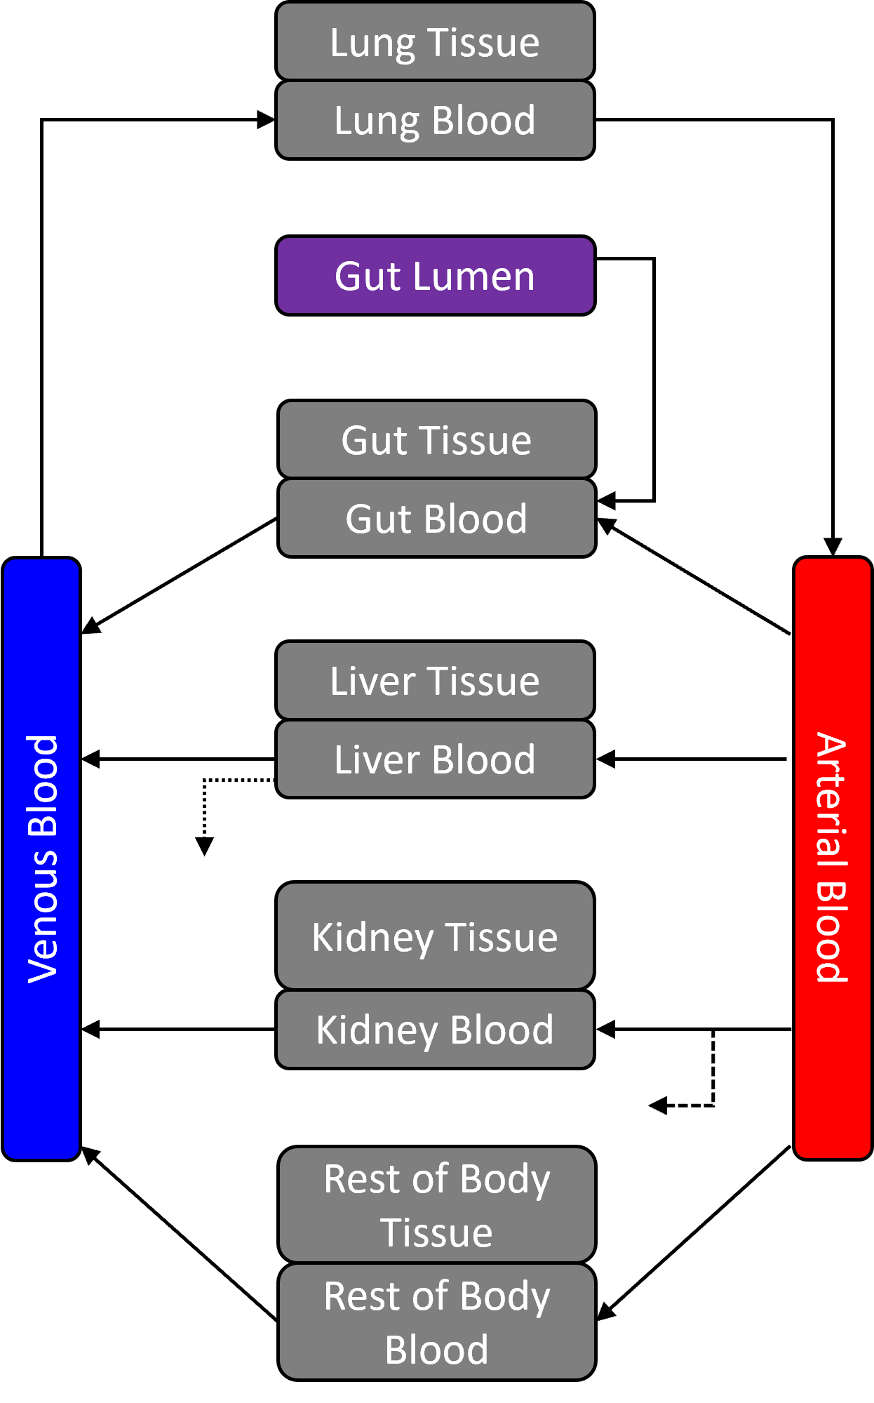
PBTK Modeling Overview
Physiologically-based toxicokinetic (PBTK) or pharmacokinetic (PBPK) models predict how a chemical moves through the body
Illustrates absorption, distribution, metabolism, and excretion (ADME) processes (‘what the body does to the chemical’)
Models consist of a system of ordinary differential equations (ODEs), where each equation describes the rate of change of the chemical amount/concentration in a model compartment over time
Compartments typically represent specific organs or tissues (may include other anatomical elements)
May consist of lumped compartments

Slide 5
Available Dosing Scenarios
Single Dose
One dose that does not repeat
Example: 1 dose at 8:00am
Multiple Doses
Evenly distributed daily doses (ideal for pharmaceuticals)
Dose amounts and times must be the same daily during every administration
Example: 1 dose every 8 hrs
Unevenly distributed doses (ideal for food)
Dose amounts may be different during every dose
Dose times can be uneven across 24 hrs
Doses do not need to occur daily
Example: 1 dose at 8:00am, 12:00pm, and 6:00pm daily
24-hour period
24-hour period

Slide 6
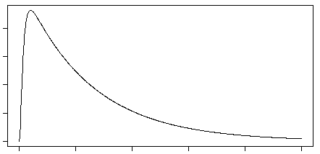
Concentration-Time Profile Module Outputs
Plots and tables of the concentrations or amounts of a chemical over time in each model compartment
Summary statistics of the concentration-time profile curves within each model compartment
Cmax – maximal concentration or amount
Tmax – time to Cmax
AUC – area under the curve of each compartment
Cmax
AUC
Tmax

Slide 7
Concentration-Time Profile Module Inputs
Required:
Species and species preferences (if applicable)
Model selection
Number of simulation days
In silico parameter preference
Dosing method, units, frequency, and amount
Chemicals to simulate
Optional:
Initial compartment values
Bioavailability settings
Model solver settings
Model calculation preferences involving the hepatic clearance, fraction unbound in plasma, ratio of chemical concentration in blood to plasma, and partition coefficients

Slide 8
Example 1 Scenario
Obtain the concentration-time profiles of five indirect food additives during all three trimesters of human pregnancy
Use the available in silico parameters
Orally consumes 0.5 mg/kg BW of each chemical twice a day (every 12 hours), every day for the entire pregnancy
Chemical Name | CASRN
Cyclohexylamine | 108-91-8
Triethanolamine | 102-71-6
4,4’-sulfonyldiphenol (Bisphenol S) | 80-09-1
Ethanolamine | 141-43-5
Dodecylguanidine acetate (Diodine) | 2439-10-3

Slide 9
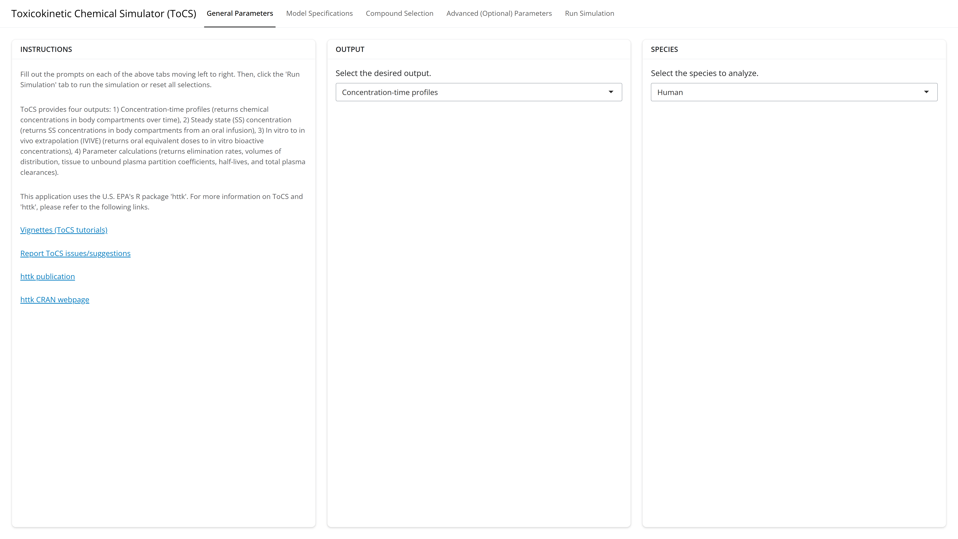
Example 1: General Parameters Tab

Slide 10
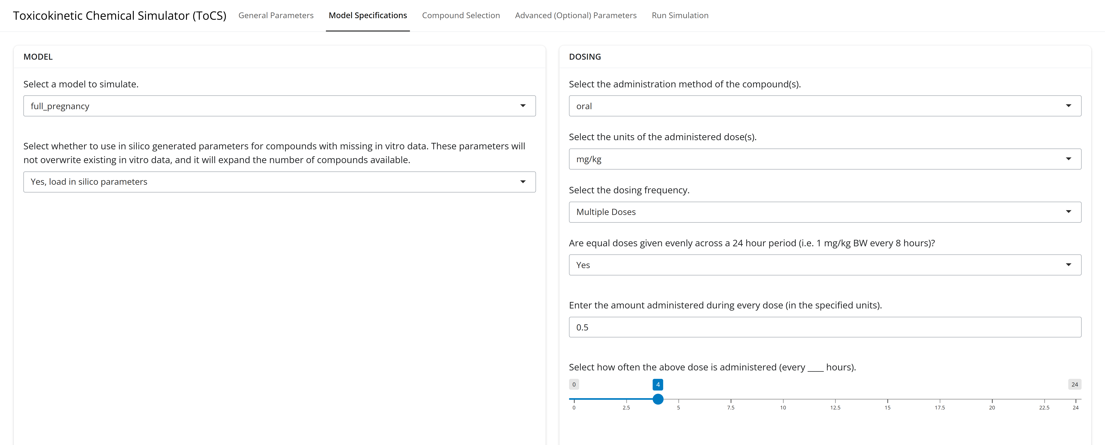
Example 1: Model Specifications Tab

Slide 11
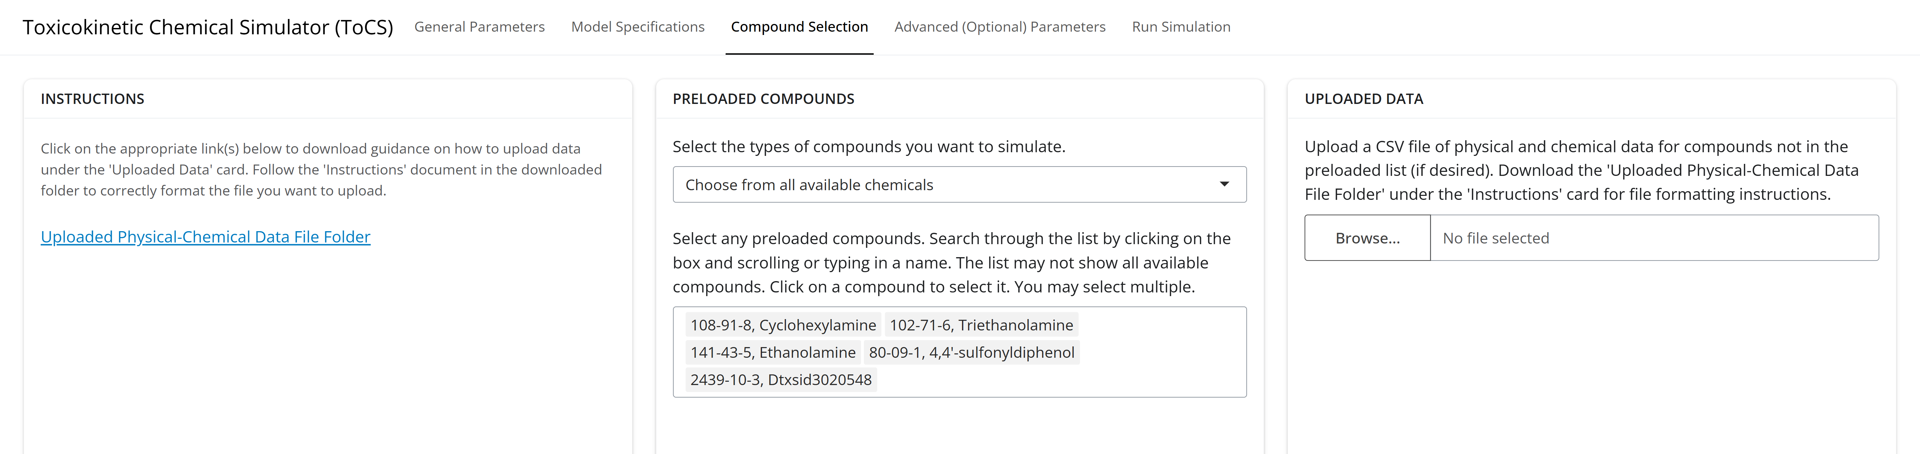
Example 1: Compound Selection Tab

Slide 12
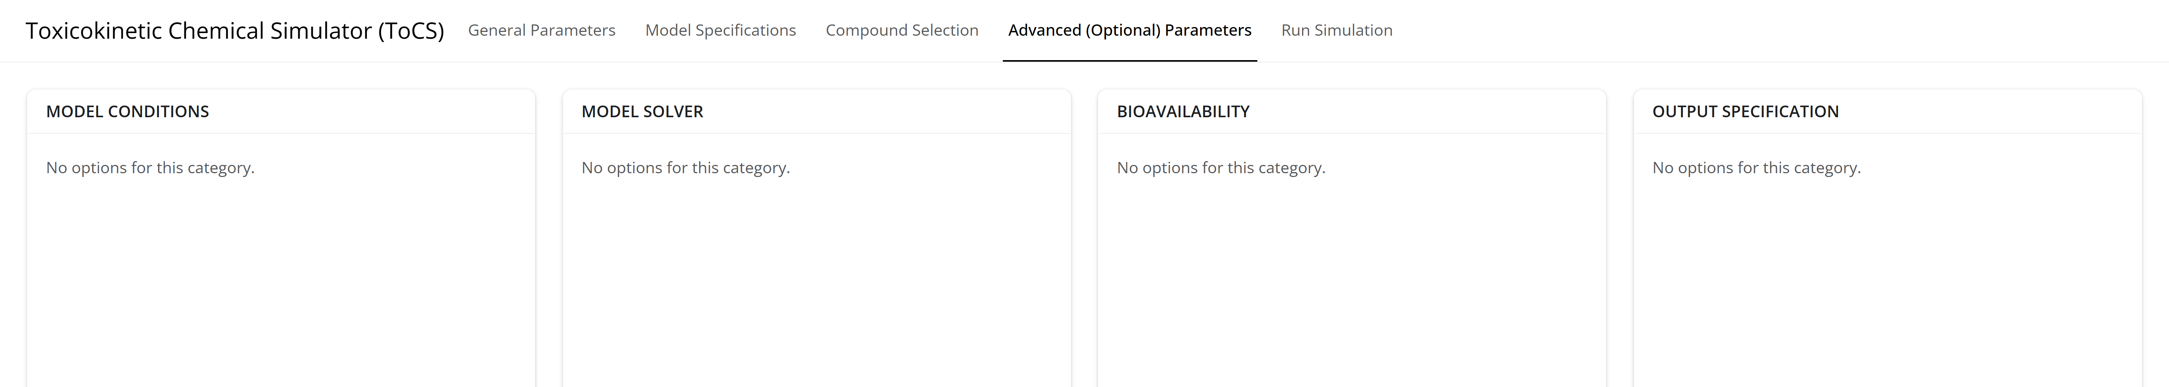
Example 1: Advanced Parameters Tab

Slide 13
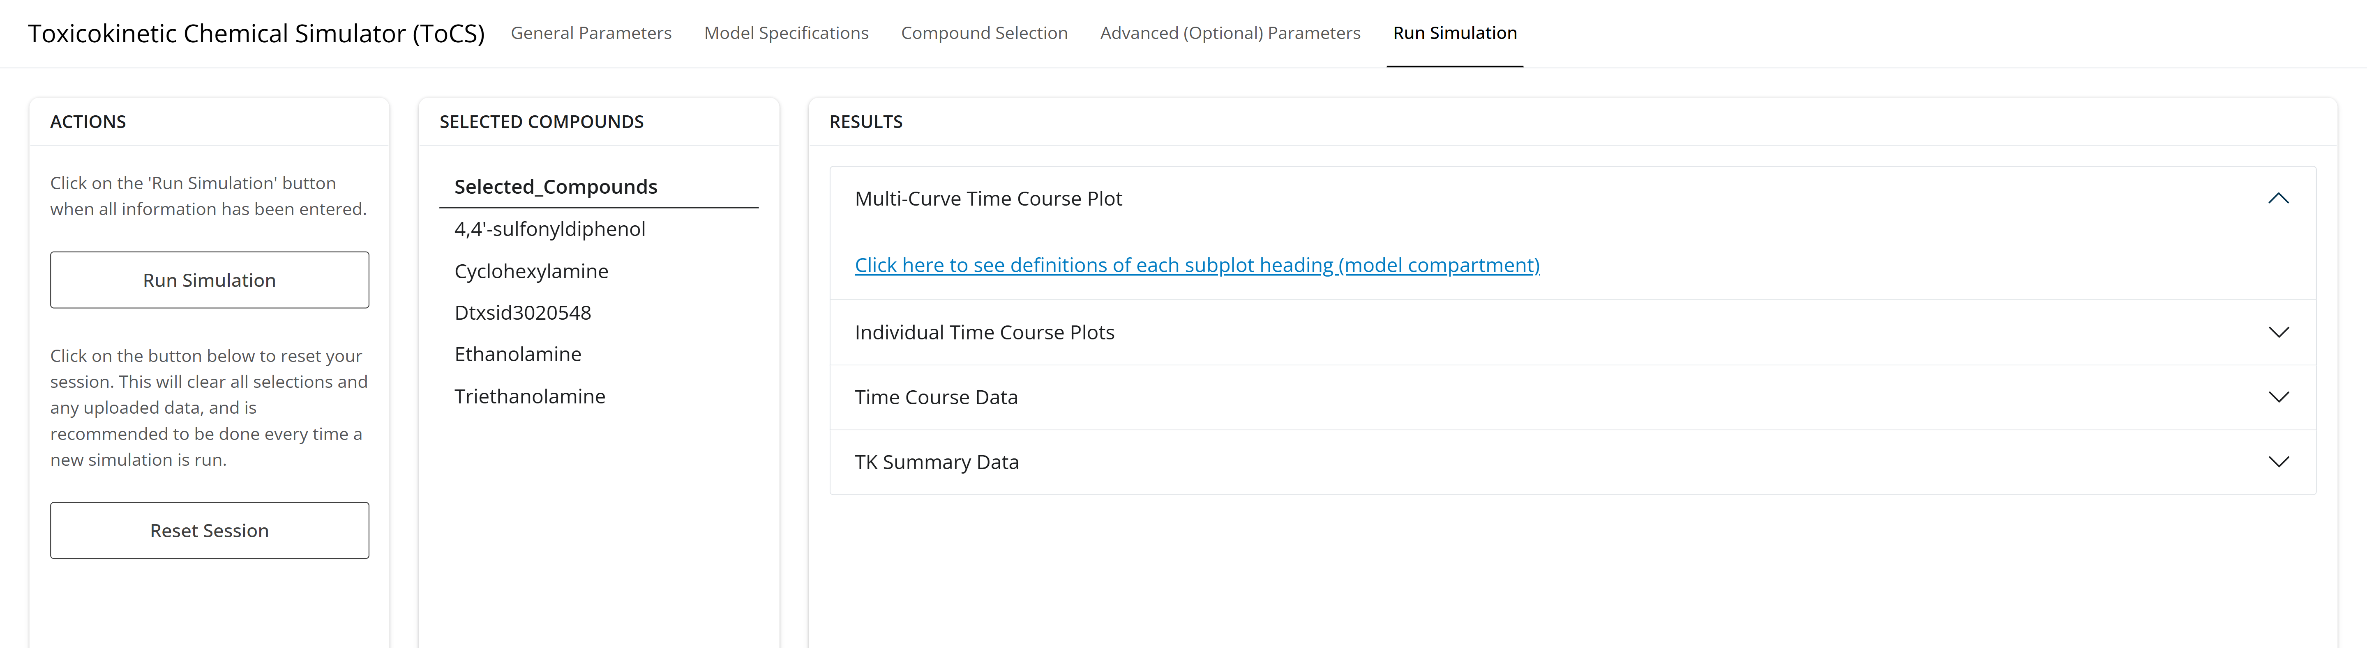
Example 1: Run Simulation Tab

Slide 14
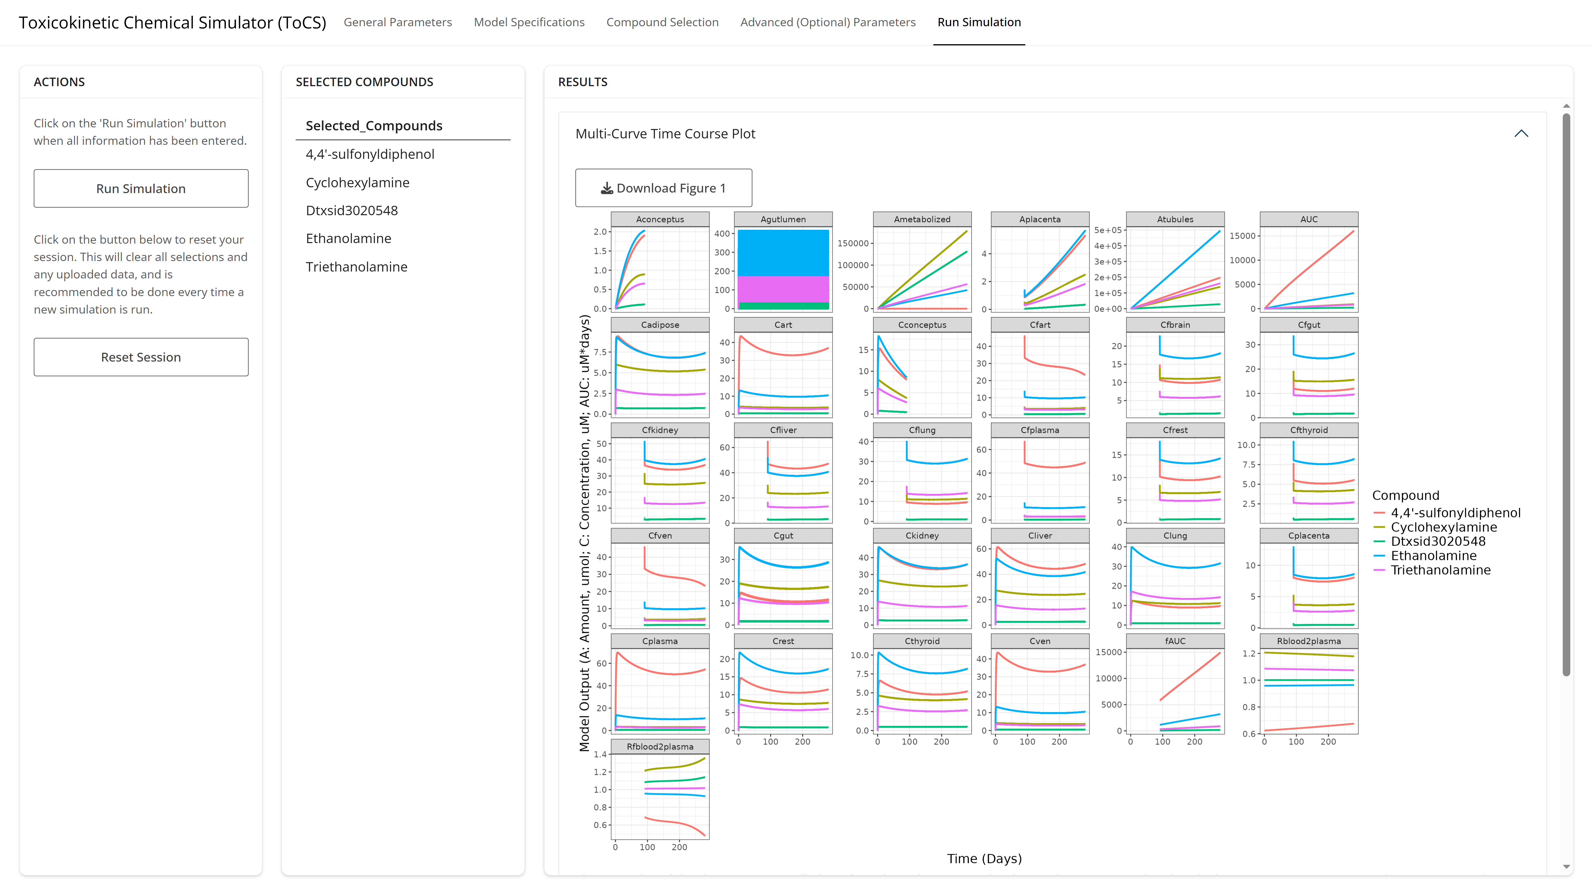
Example 1: Run Simulation Tab

Slide 15
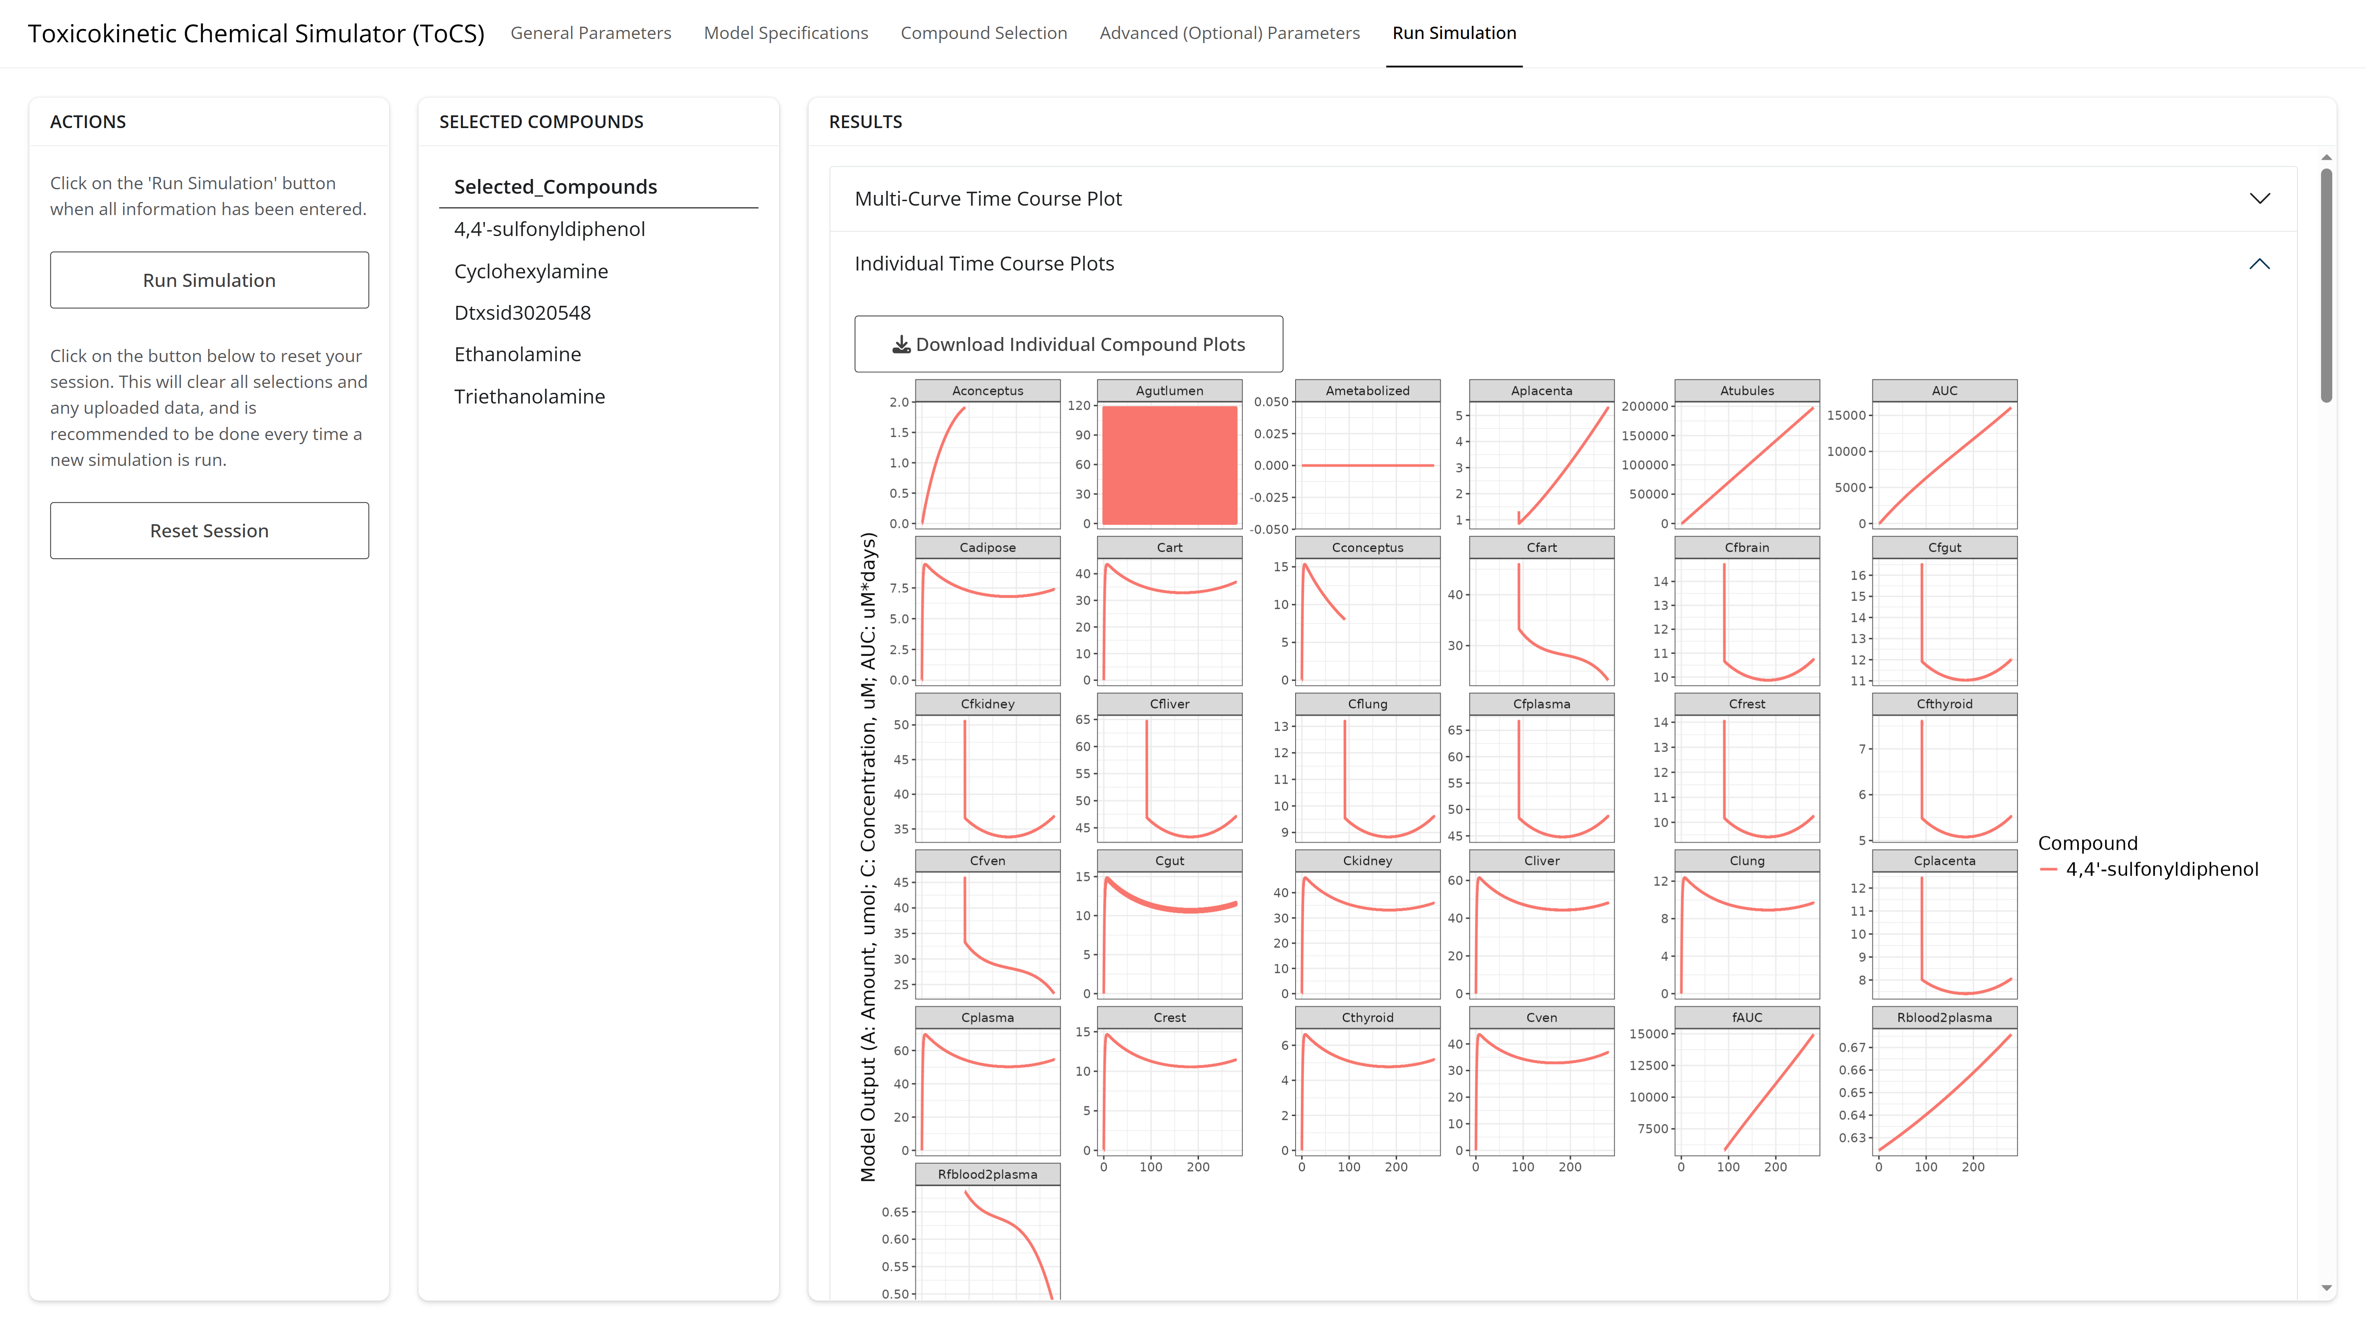
Example 1: Run Simulation Tab

Slide 16
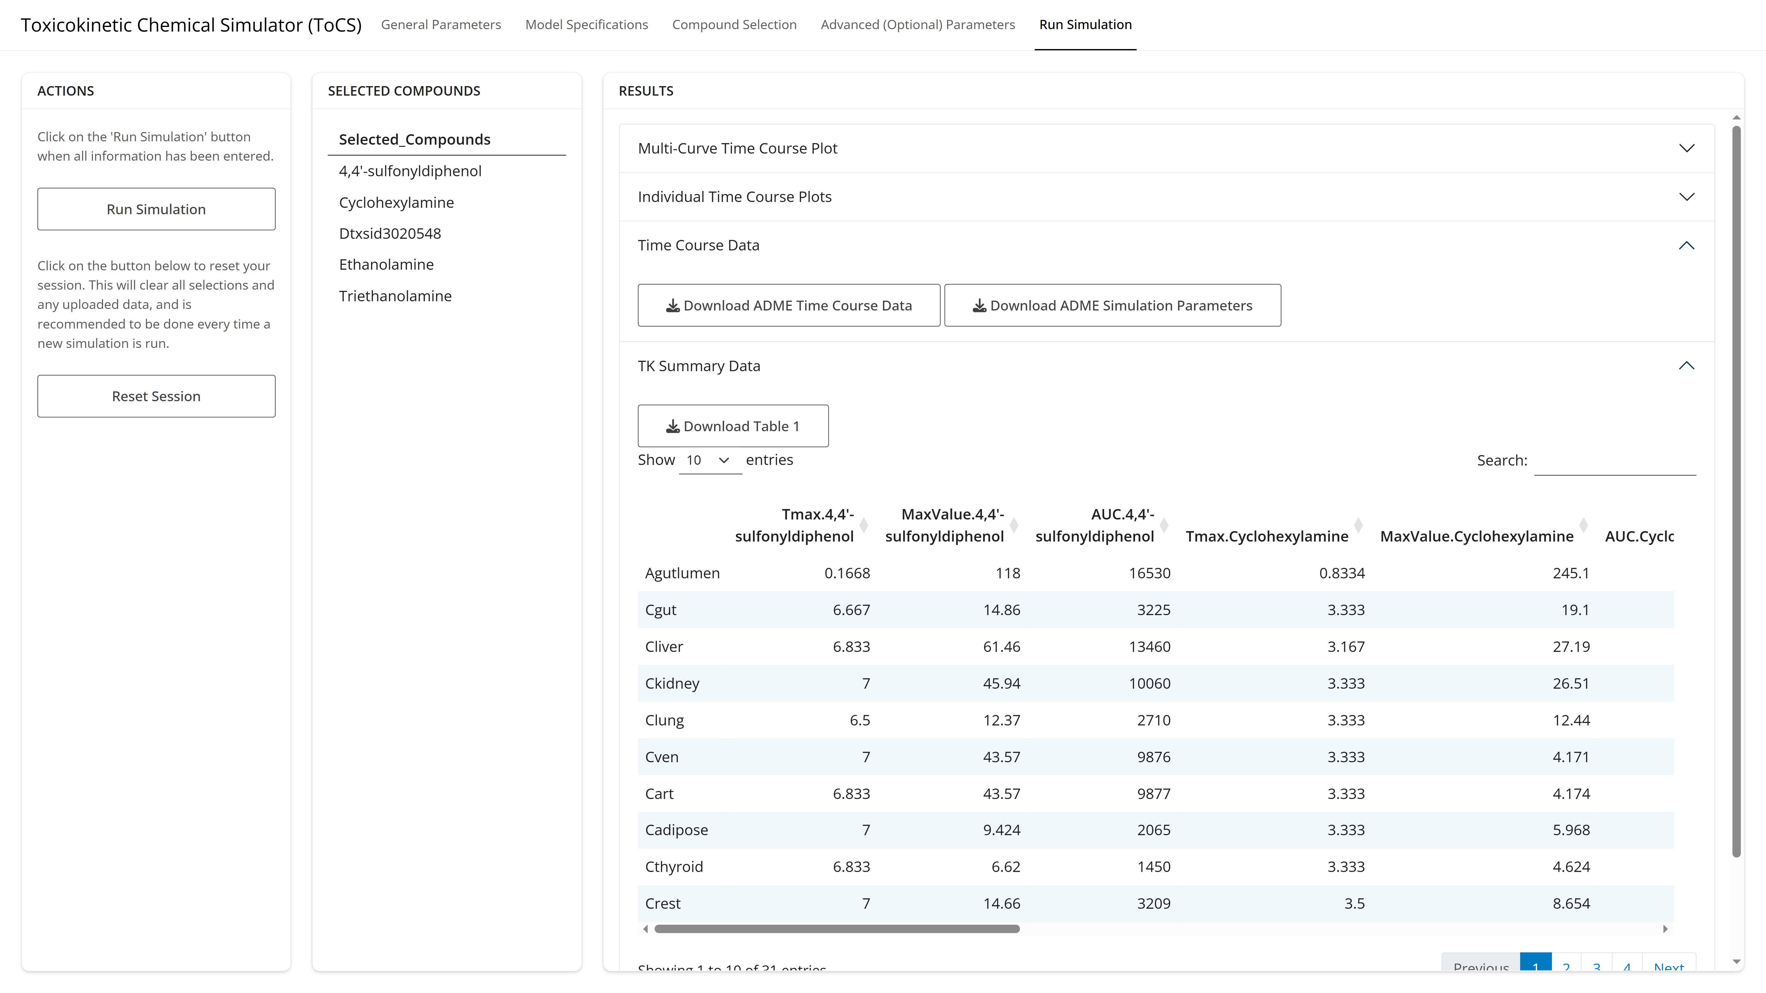
Example 1: Run Simulation Tab

Slide 17
Example 2 Scenario
Obtain the human concentration-time profiles of three food color additives using the pbtk model over 30 days
Do not use the available in silico parameters
Orally consume 1 mg/kg BW of each chemical at the start of every other day
Use the default caco-2 apical-to-basal membrane permeability value
Chemical Name | CASRN
FD&C Yellow 6 | 2783-94-0
FD&C Green 1 | 2353-45-9
Ponceau 4R | 2611-82-7
Notes:
0,2,4,6,8,10,12,14,16,18,20,22,24,26,28,1,1,1,1,1,1,1,1,1,1,1,1,1,1,1

Slide 18
Example 2: General Parameters Tab
Notes:
0,2,4,6,8,10,12,14,16,18,20,22,24,26,28,1,1,1,1,1,1,1,1,1,1,1,1,1,1,1

Slide 19
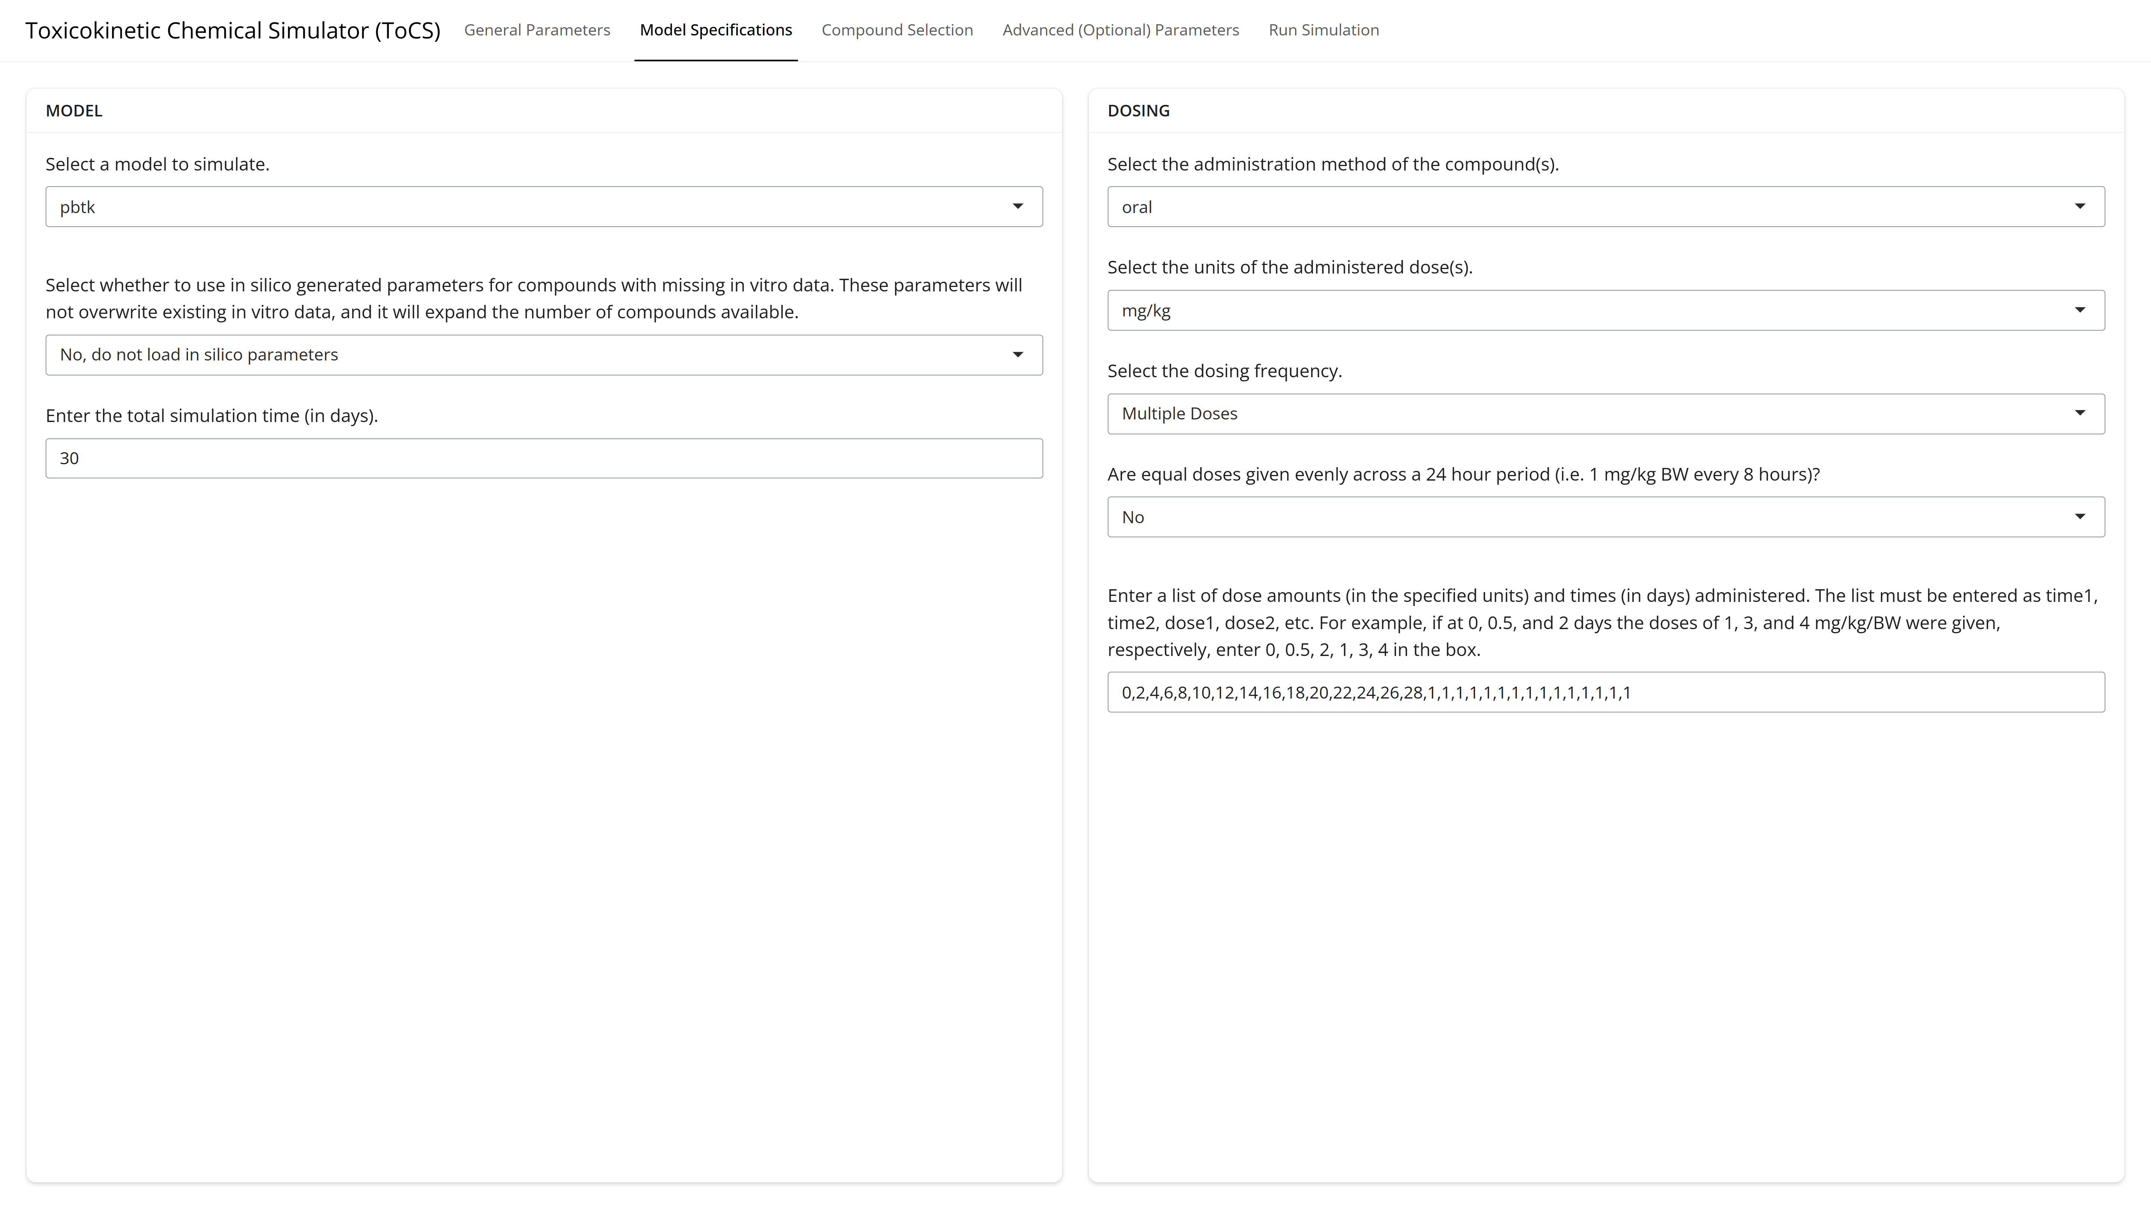
Example 2: Model Specifications Tab
Notes:
0,2,4,6,8,10,12,14,16,18,20,22,24,26,28,1,1,1,1,1,1,1,1,1,1,1,1,1,1,1

Slide 20
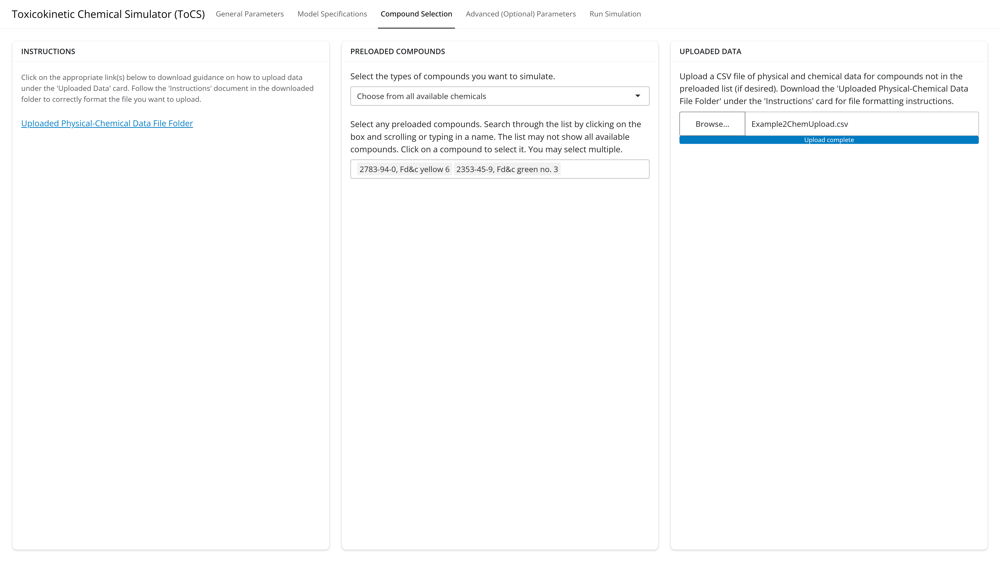
Example 2: Compound Selection Tab
Notes:
0,2,4,6,8,10,12,14,16,18,20,22,24,26,28,1,1,1,1,1,1,1,1,1,1,1,1,1,1,1

Slide 21
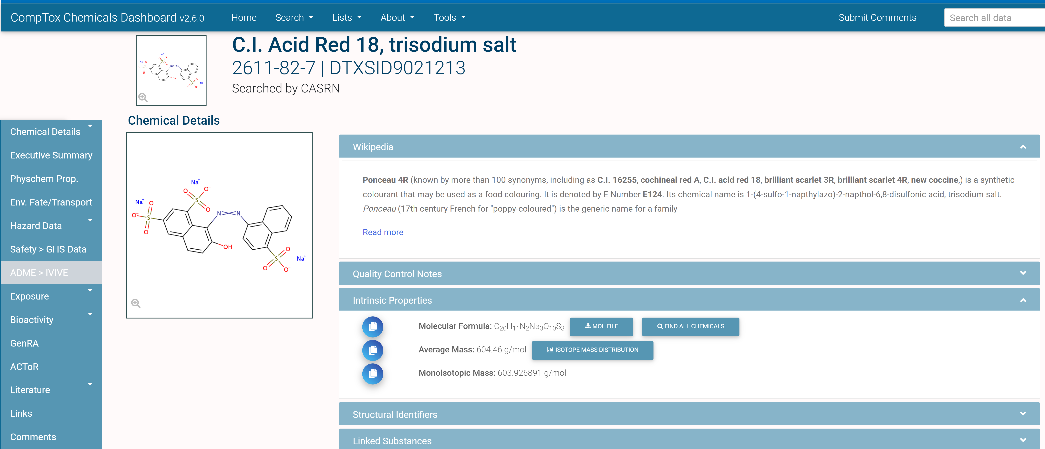
Example 2: Uploading Data for Ponceau 4R
Notes:
0,2,4,6,8,10,12,14,16,18,20,22,24,26,28,1,1,1,1,1,1,1,1,1,1,1,1,1,1,1

Slide 22
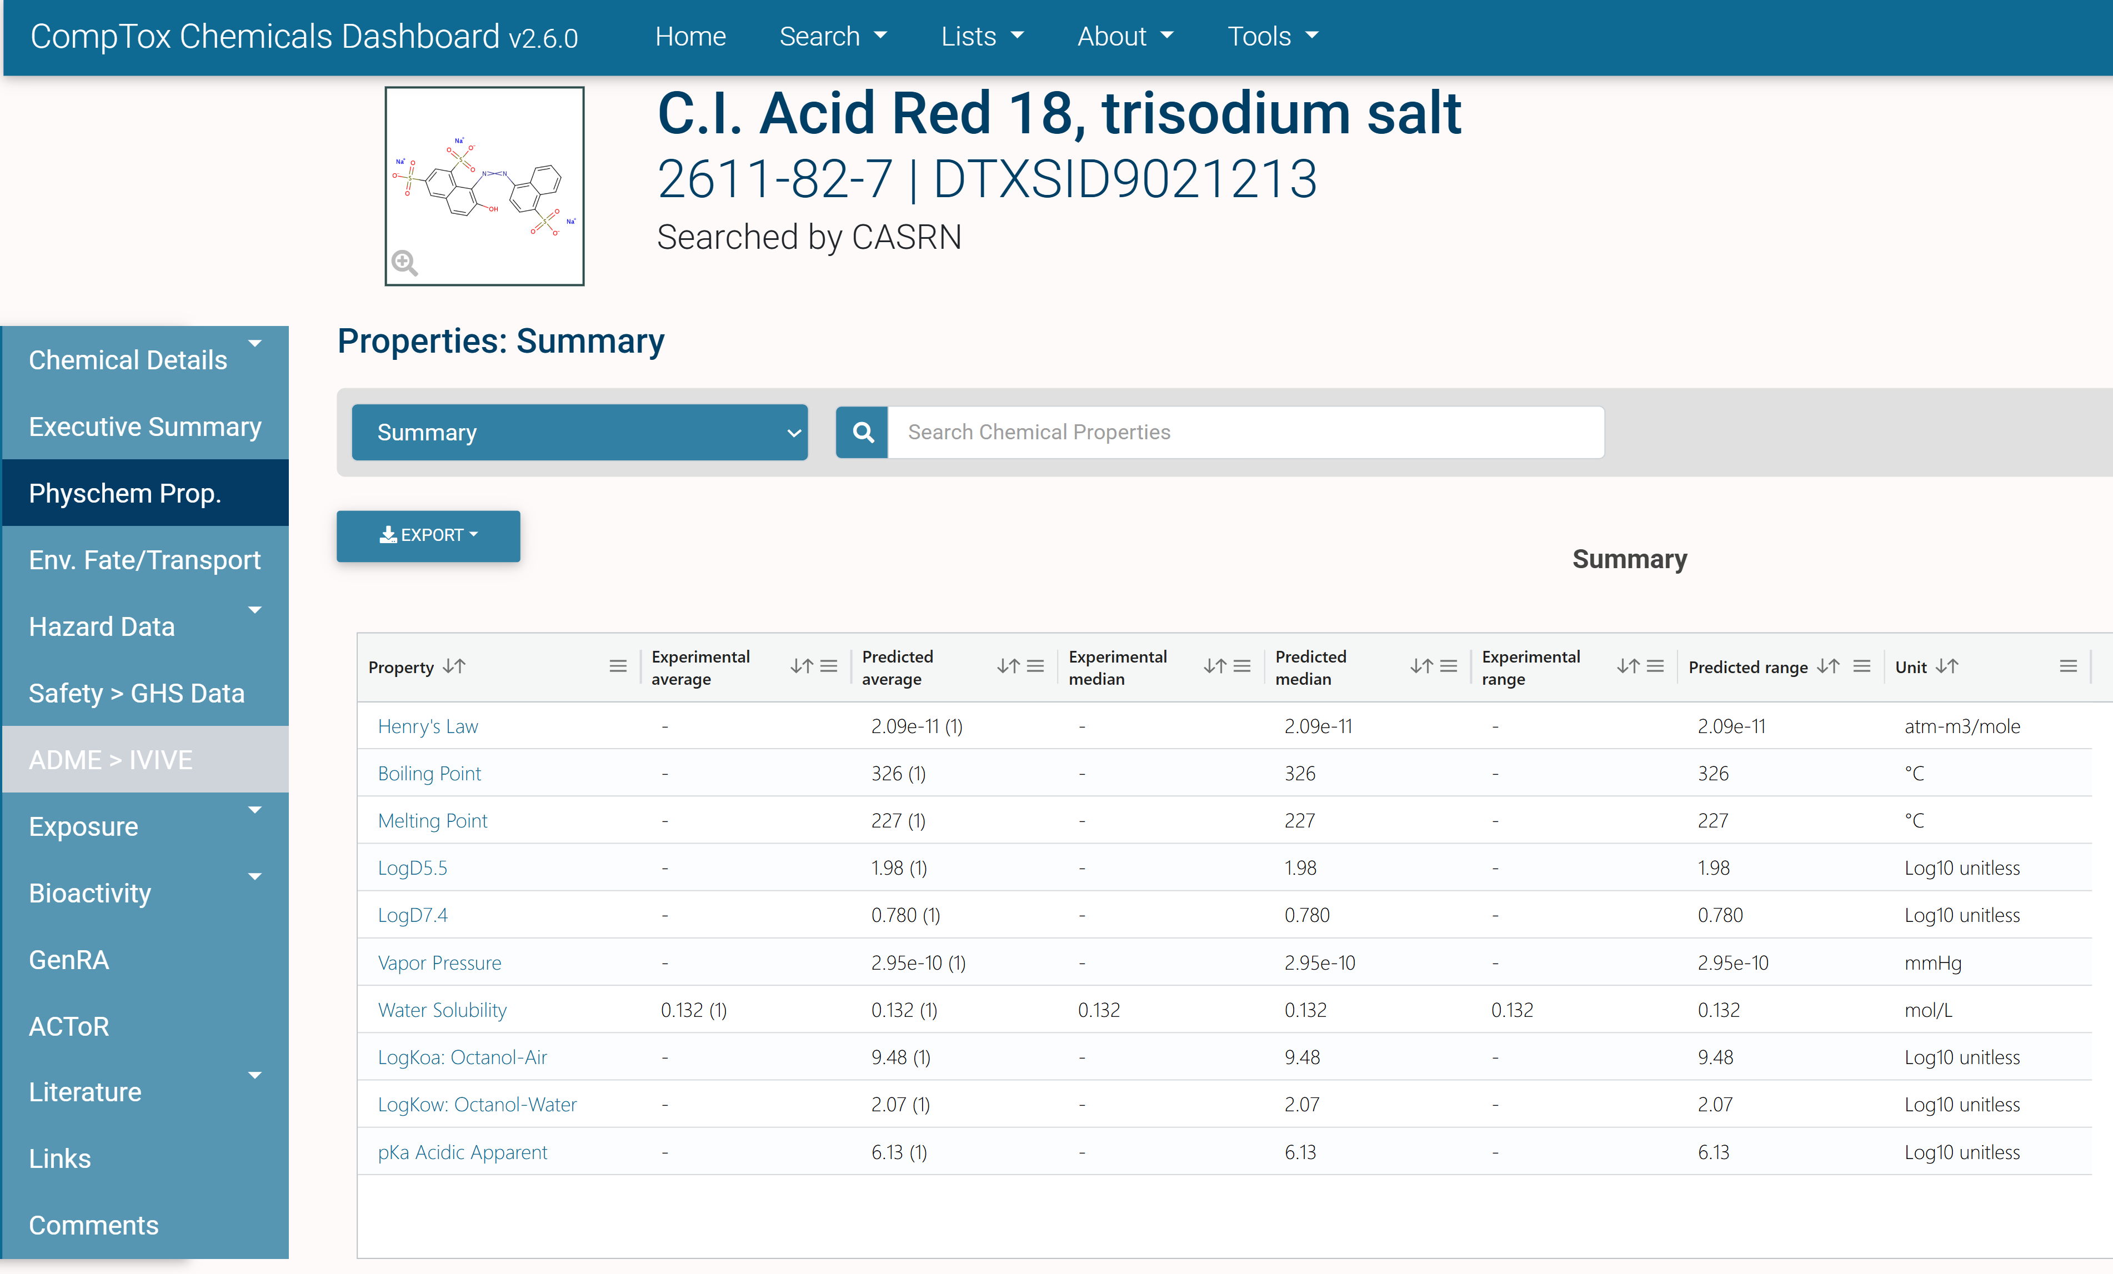
Example 2: Uploading Data for Ponceau 4R
Notes:
0,2,4,6,8,10,12,14,16,18,20,22,24,26,28,1,1,1,1,1,1,1,1,1,1,1,1,1,1,1

Slide 23
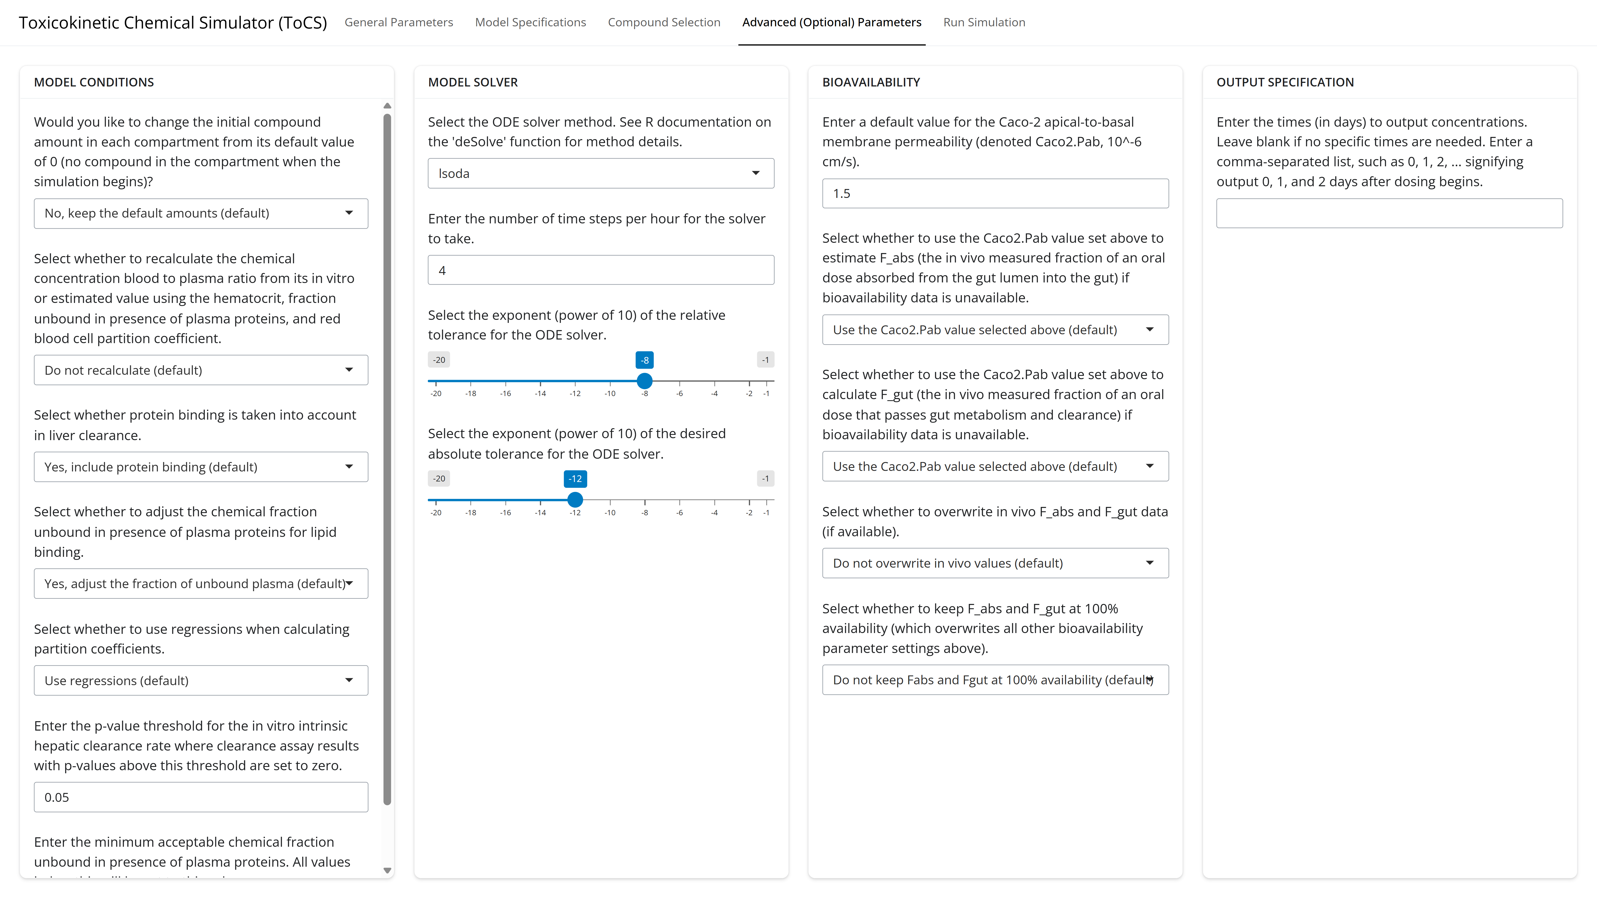
Example 2: Advanced Parameters Tab
Notes:
0,2,4,6,8,10,12,14,16,18,20,22,24,26,28,1,1,1,1,1,1,1,1,1,1,1,1,1,1,1

Slide 24
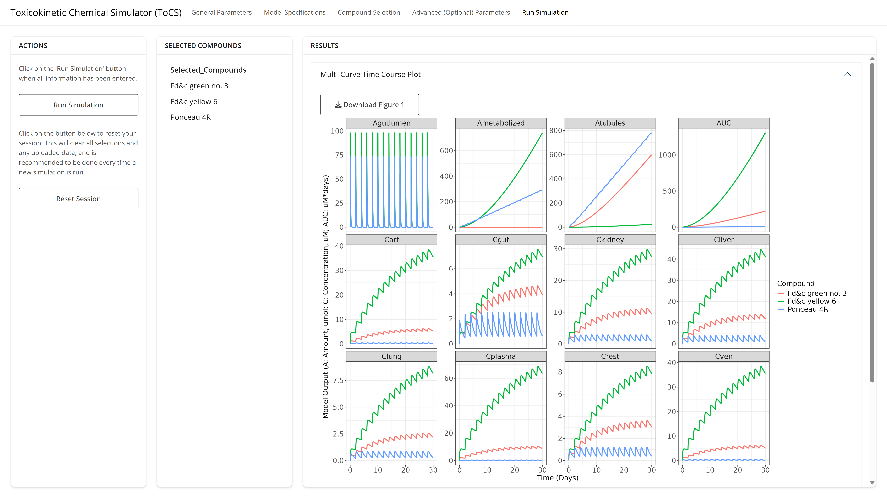
Example 2: Run Simulation Tab
Notes:
0,2,4,6,8,10,12,14,16,18,20,22,24,26,28,1,1,1,1,1,1,1,1,1,1,1,1,1,1,1

Slide 25
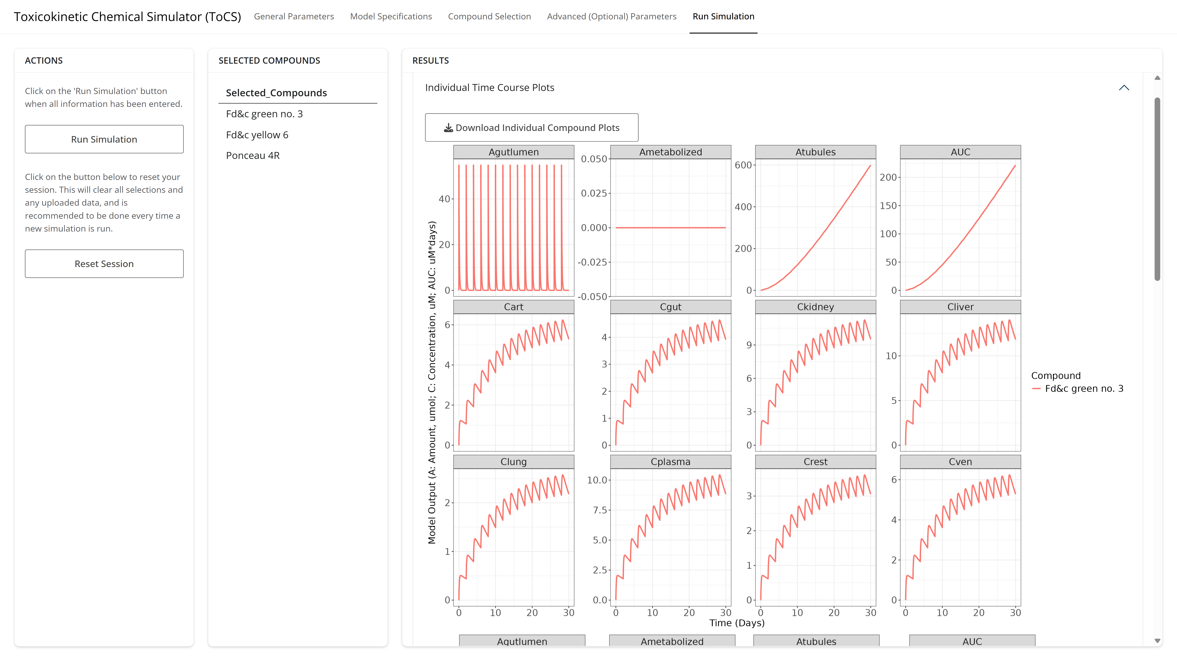
Example 2: Run Simulation Tab
Notes:
0,2,4,6,8,10,12,14,16,18,20,22,24,26,28,1,1,1,1,1,1,1,1,1,1,1,1,1,1,1

Slide 26
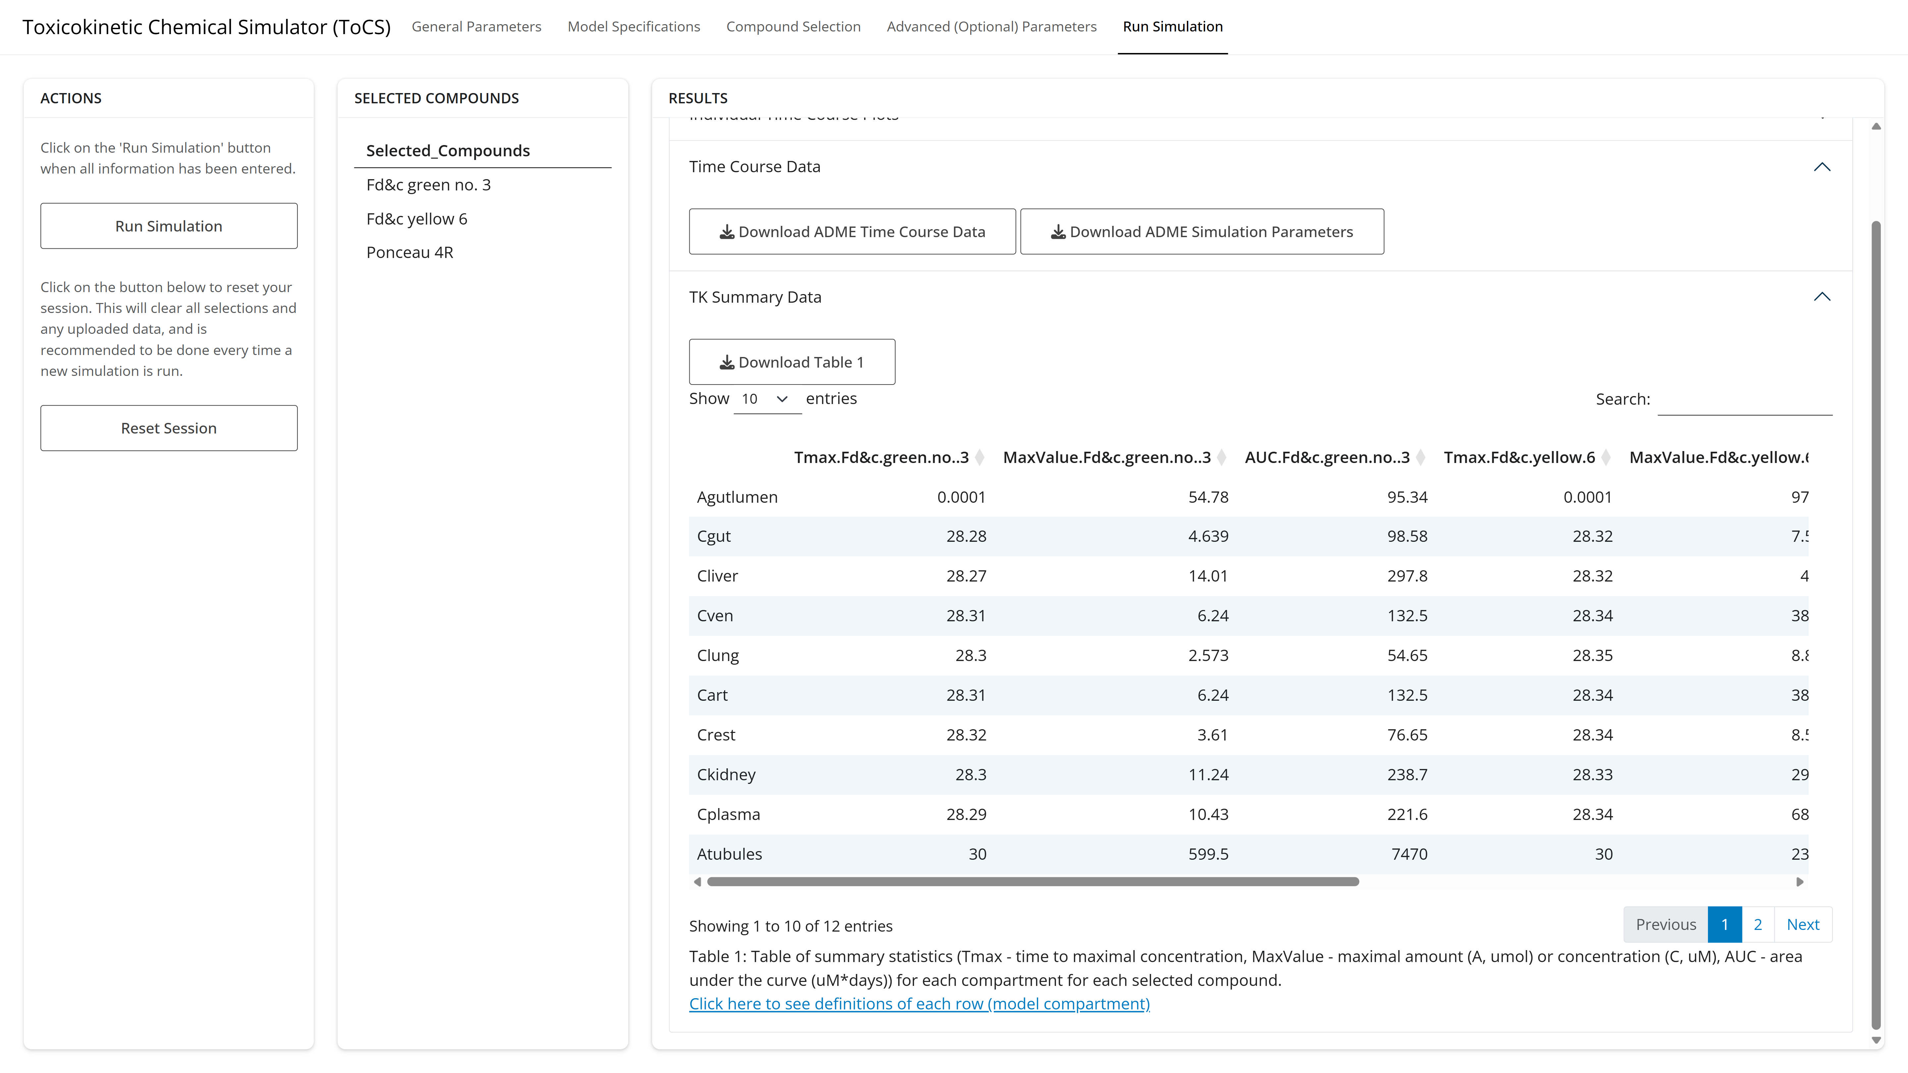
Example 2: Run Simulation Tab
Notes:
0,2,4,6,8,10,12,14,16,18,20,22,24,26,28,1,1,1,1,1,1,1,1,1,1,1,1,1,1,1

Slide 27
Try It On Your Own
Try your own simulation in the Concentration-Time Profiles module
OR
Obtain the rat concentration-time profiles of three chemicals of your choosing across 8 days and use the following inputs:
Use rat parameter data only
Use the 3-compartment model
Give a 2 mg/kg dose of each chemical at the start of day 0, 2, 4, and 6
Do not allow the use of in silico parameters
Use 100% bioavailability
Begin with 1 umol of each chemical in the gut

Slide 28
Questions?

Slide 29
10-Minute Break

